Slide 1
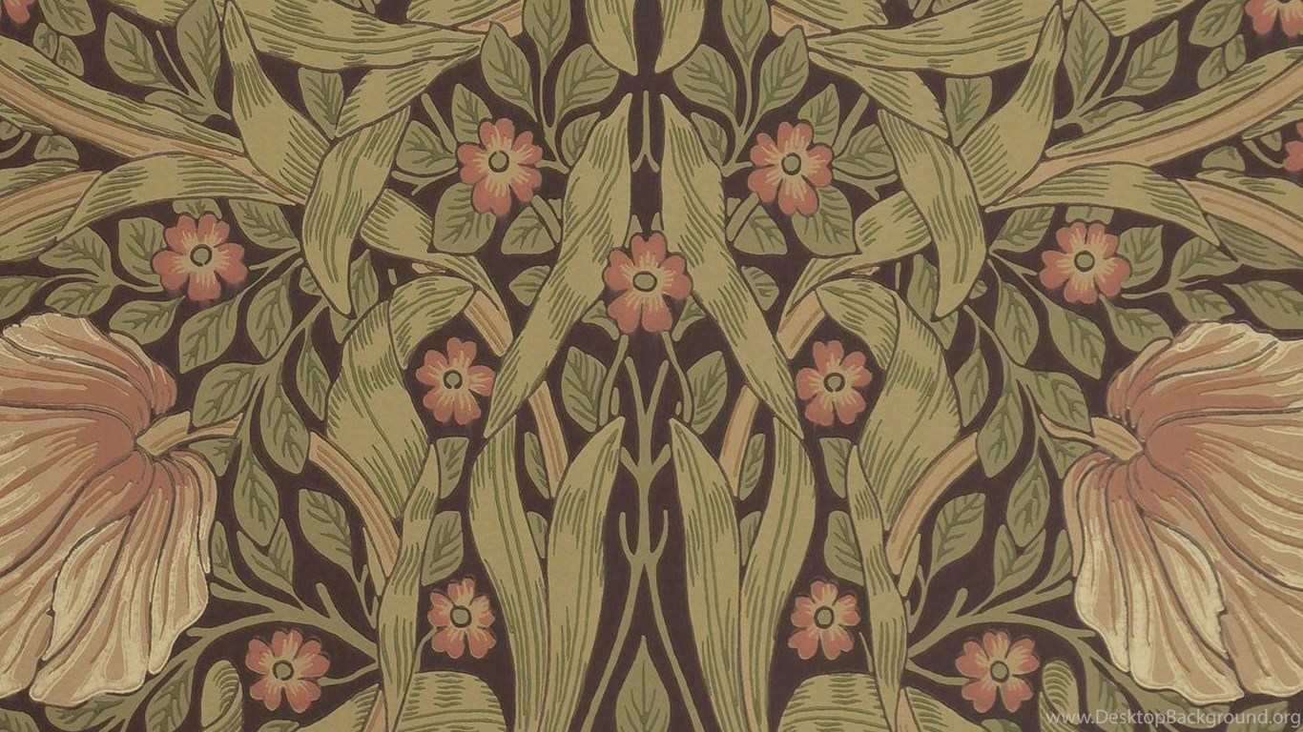
Dante Gabriel Rossetti and Christina Rossetti

Slide 2
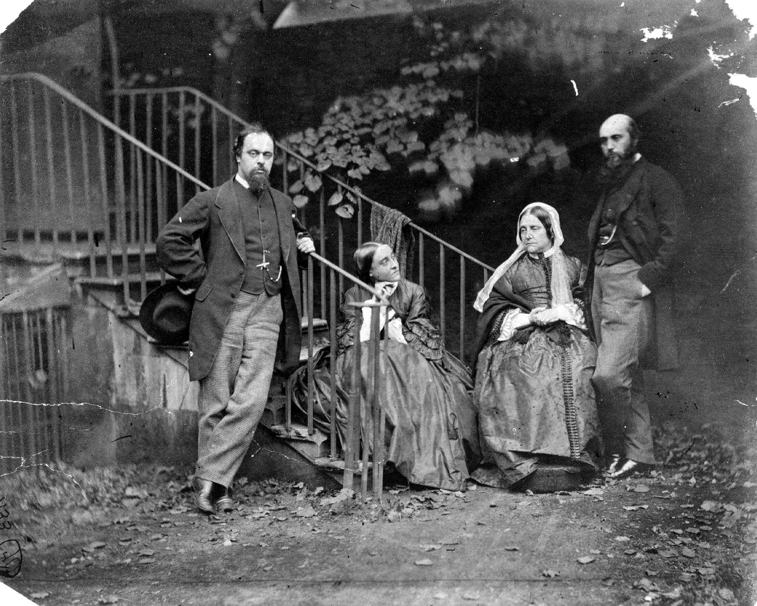
Rossetti family. Photograph by Lewis Carroll.

Slide 3
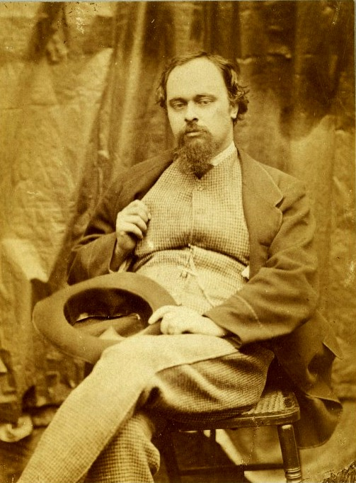
Dante Gabriel Rossetti. Photograph by Lewis Carroll.

Slide 4
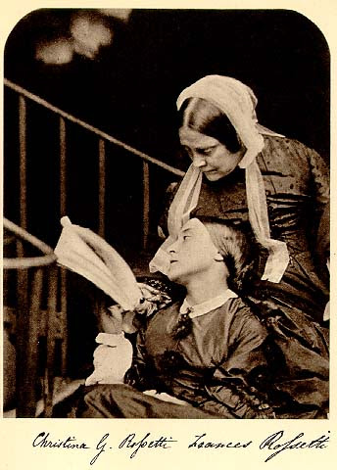
Christina Rossetti and her mother. Photograph by Lewis Carroll.

Slide 5
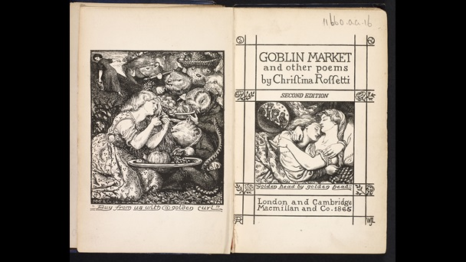
Christina Rossetti’s Goblin Market. Illustrated by Dante Gabriel Rossetti.

Slide 6
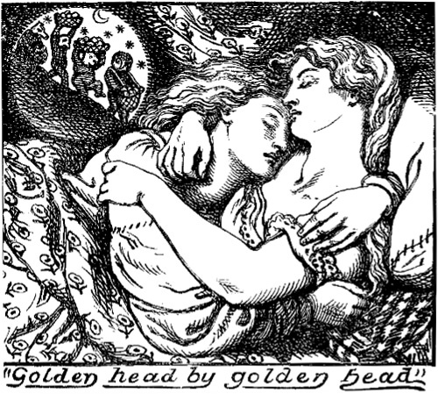
Christina Rossetti’s Goblin Market. (page 6). Illustrated by Dante Gabriel Rossetti.

Slide 7
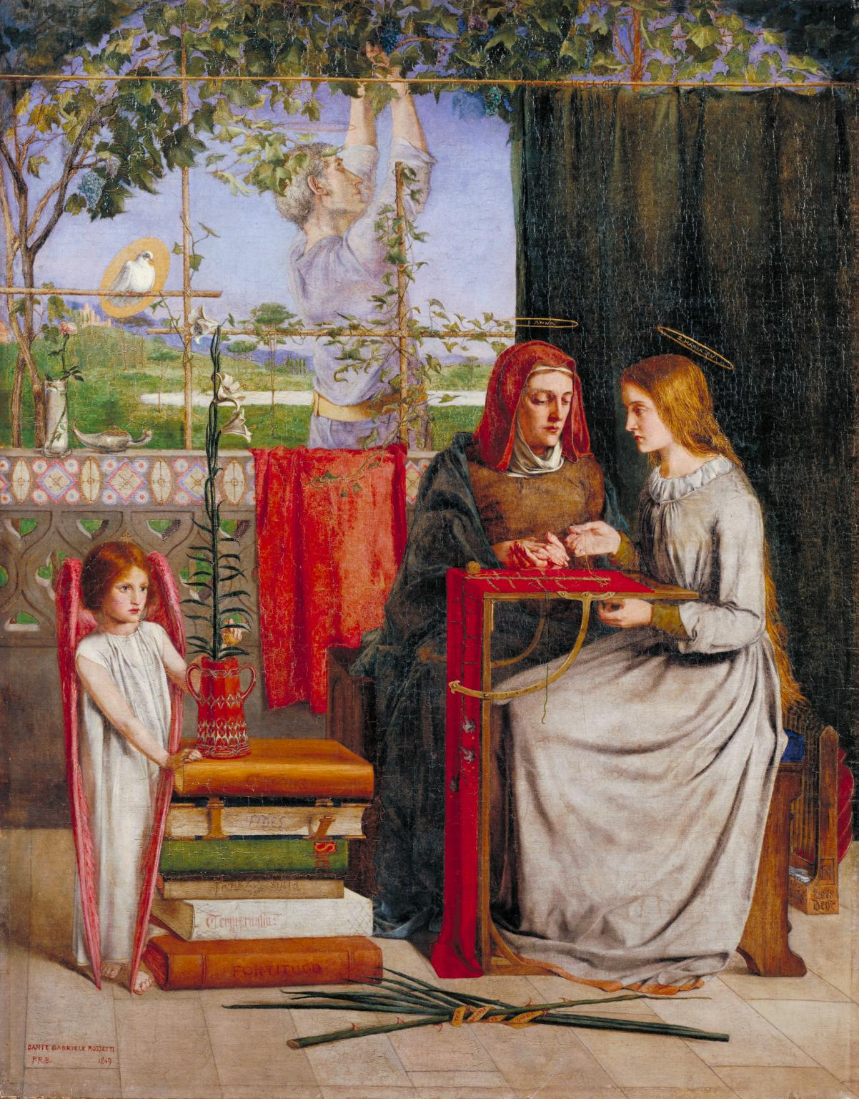
Dante Gabriel Rossetti’s The Girlhood of the Virgin Mary (1848-9).
Christina Rossetti is the model.

Slide 8
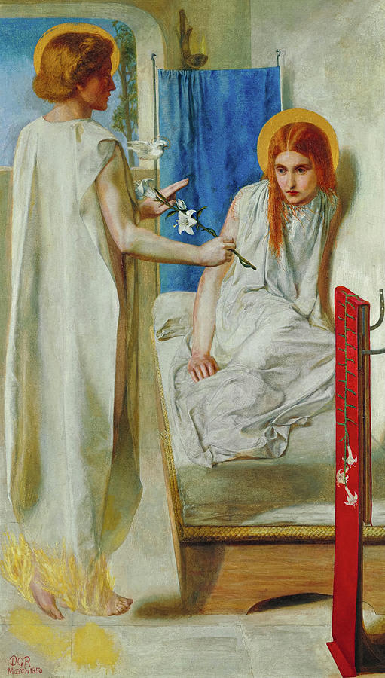
Dante Gabriel Rossetti’s The Annunciation (1850).
Christina Rossetti is the model.

Slide 9
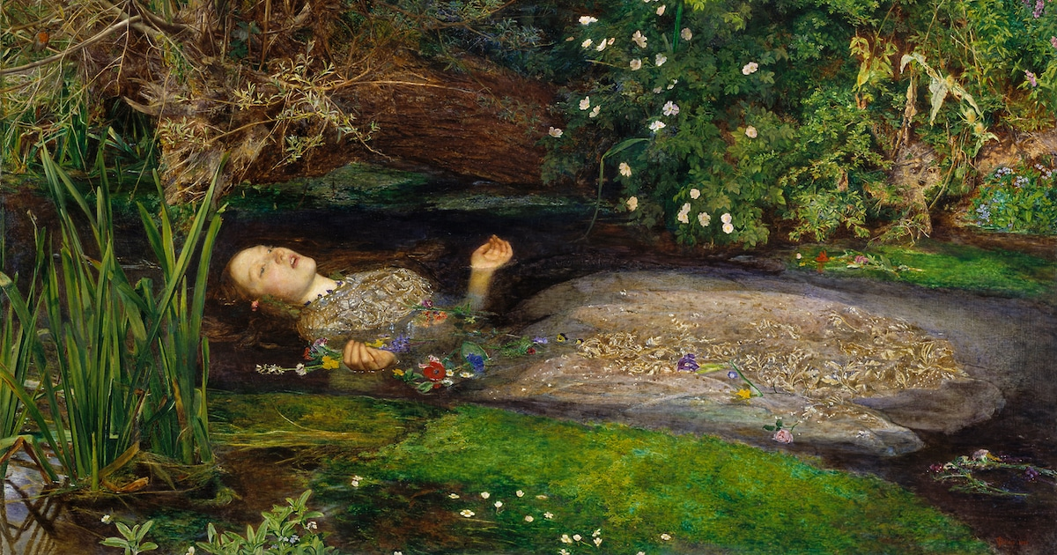
John Everett Millais’s Ophelia. Lizzie Siddall is the model.

Slide 10
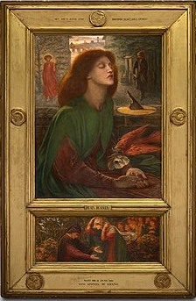
Dante Gabriel Rossetti’s Beata Beatrix. Lizzie Siddall the model.

Slide 11
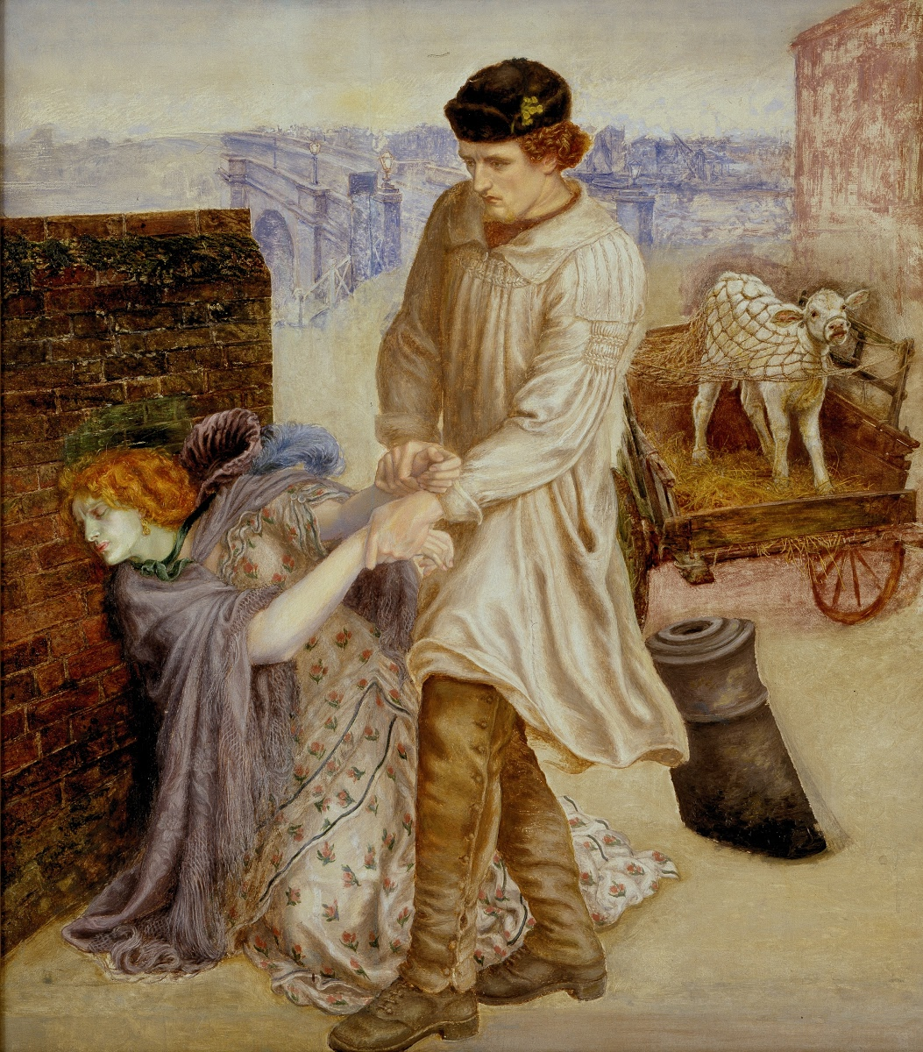
Dante Gabriel Rossetti’s Found.
Fanny Cornforth is the model.

Slide 12
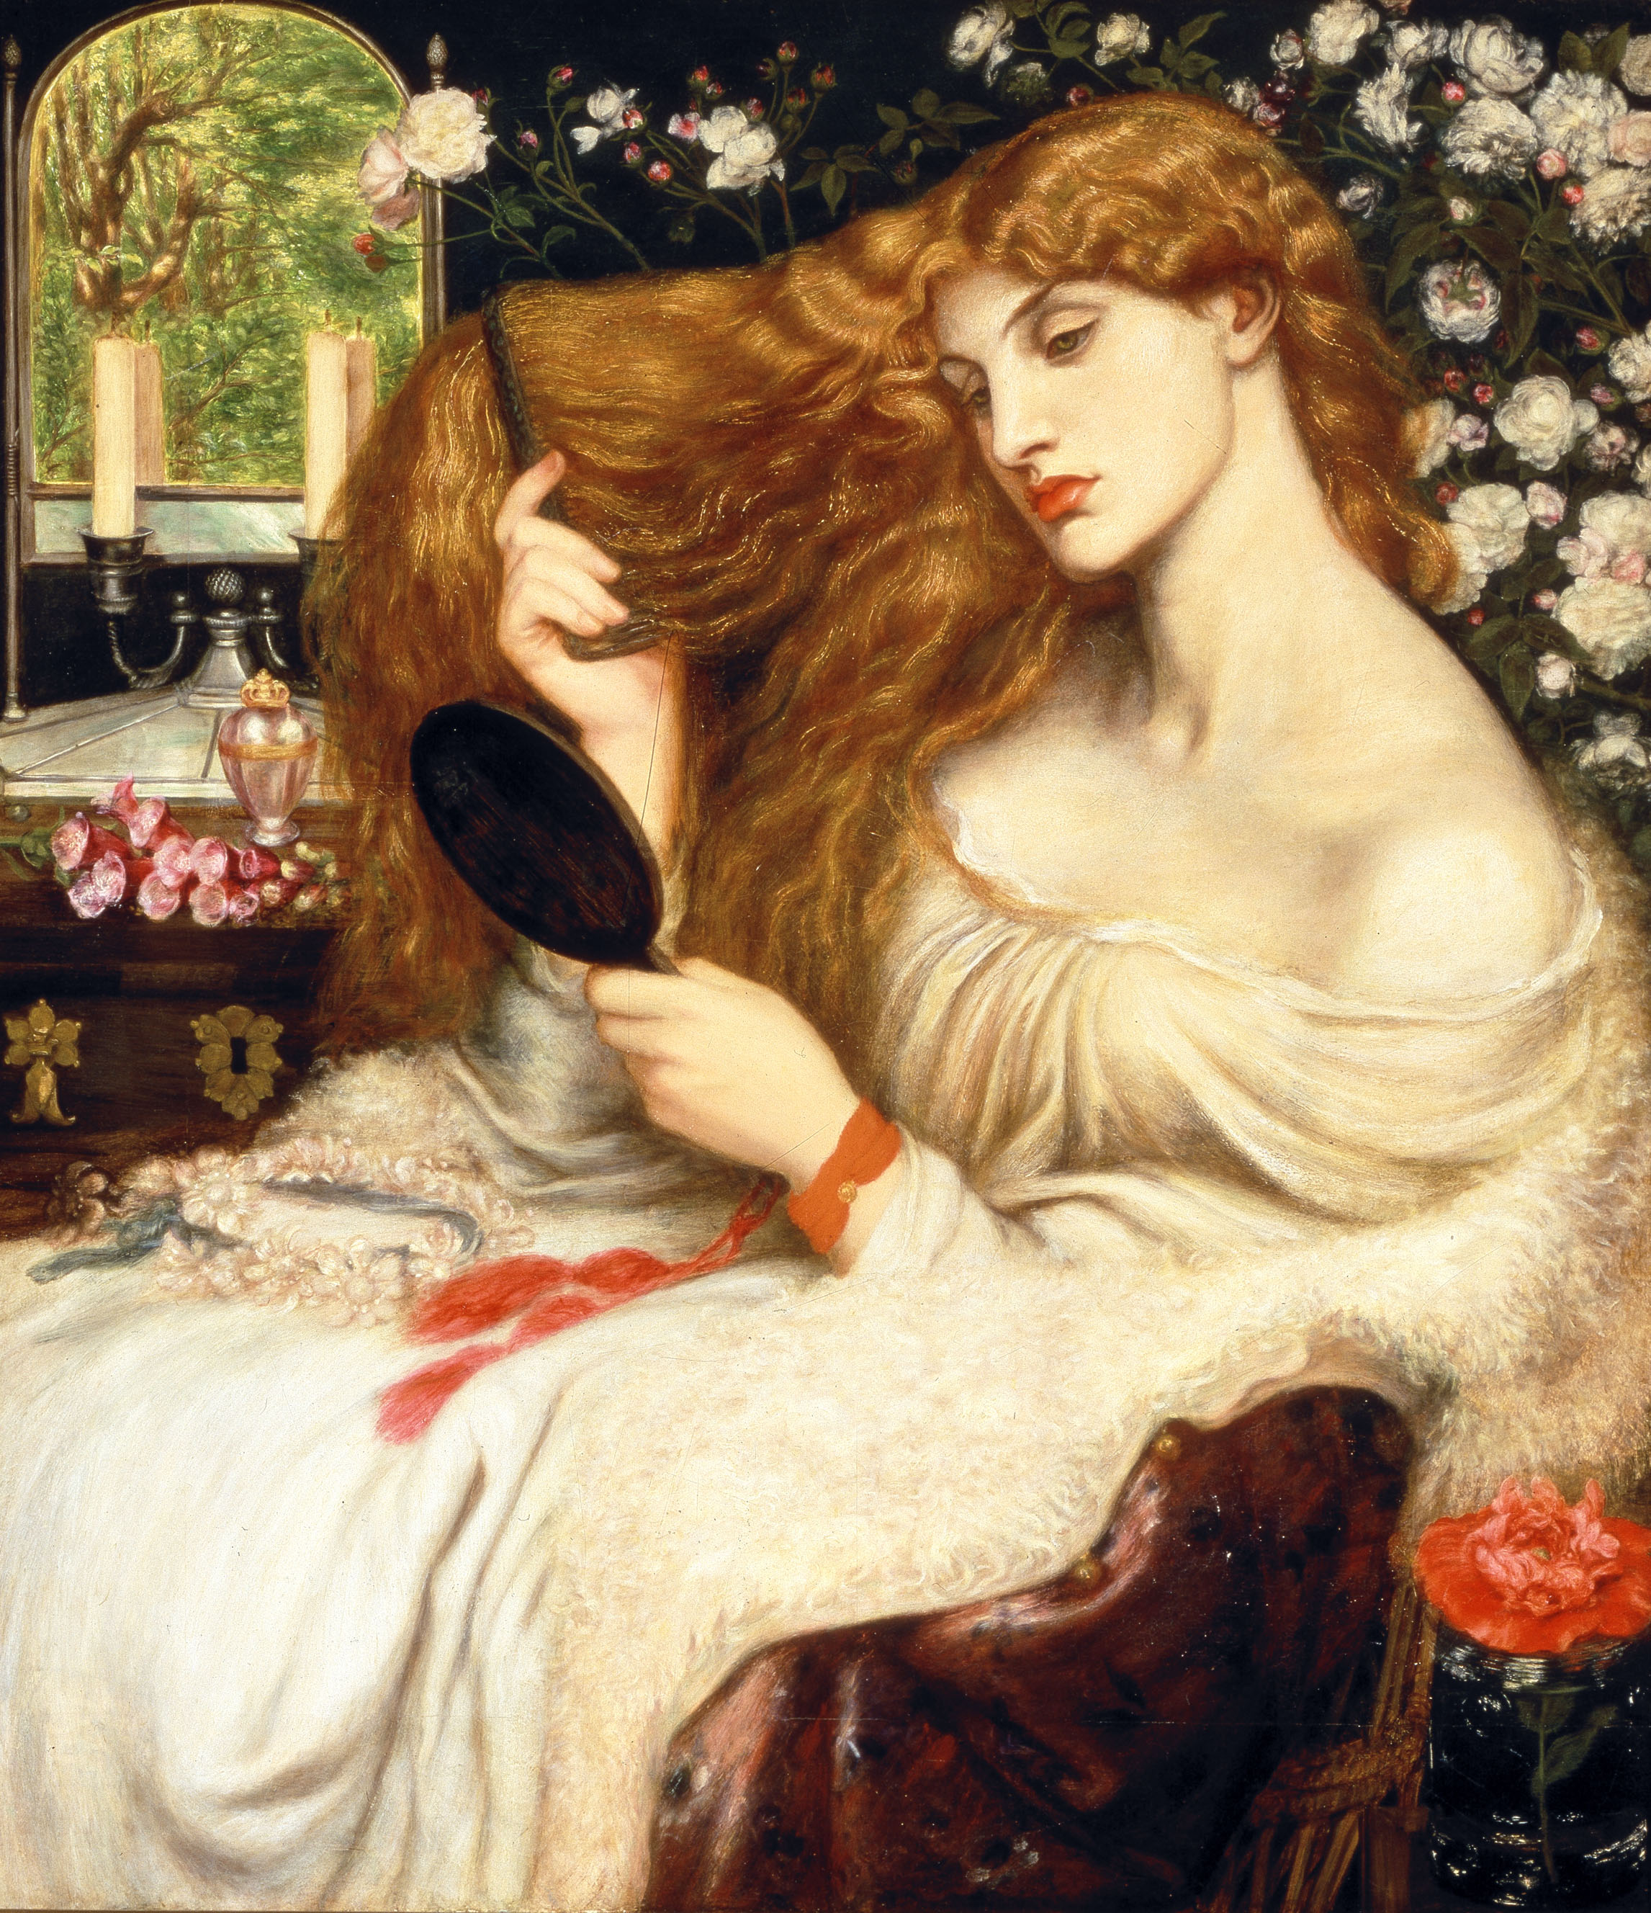
Dante Gabriel Rossetti’s Lady Lilith.
Fanny Cornforth is the model.

Slide 13
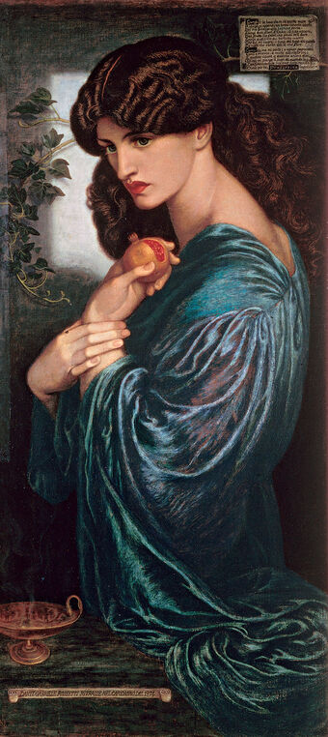
Dante Gabriel Rossetti’s Proserpine. 1874.
Jane Morris is the model.

Slide 14
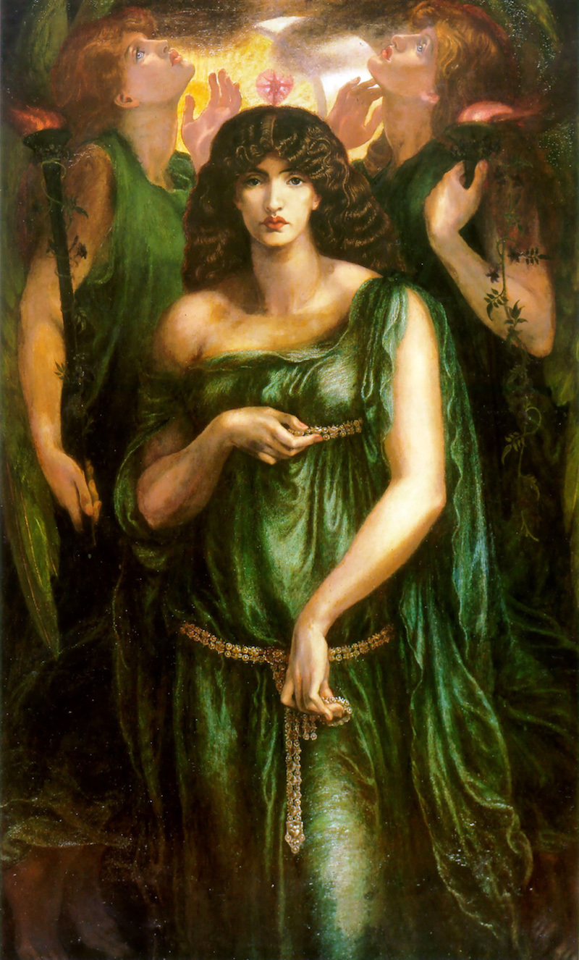
Dante Gabriel Rossetti’s Astarte Syriaca.
(1877).
Jane Morris is the model.

Slide 15
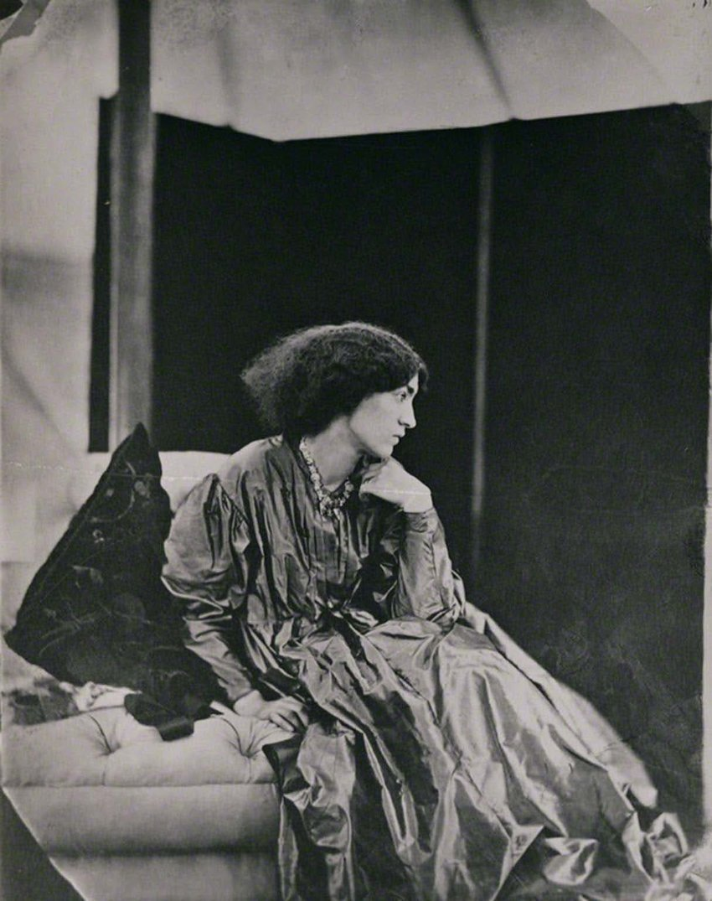
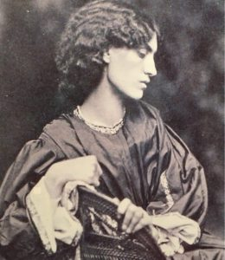
Jane Morris (1865).
Photograph by John Robert Parsons.

Slide 16
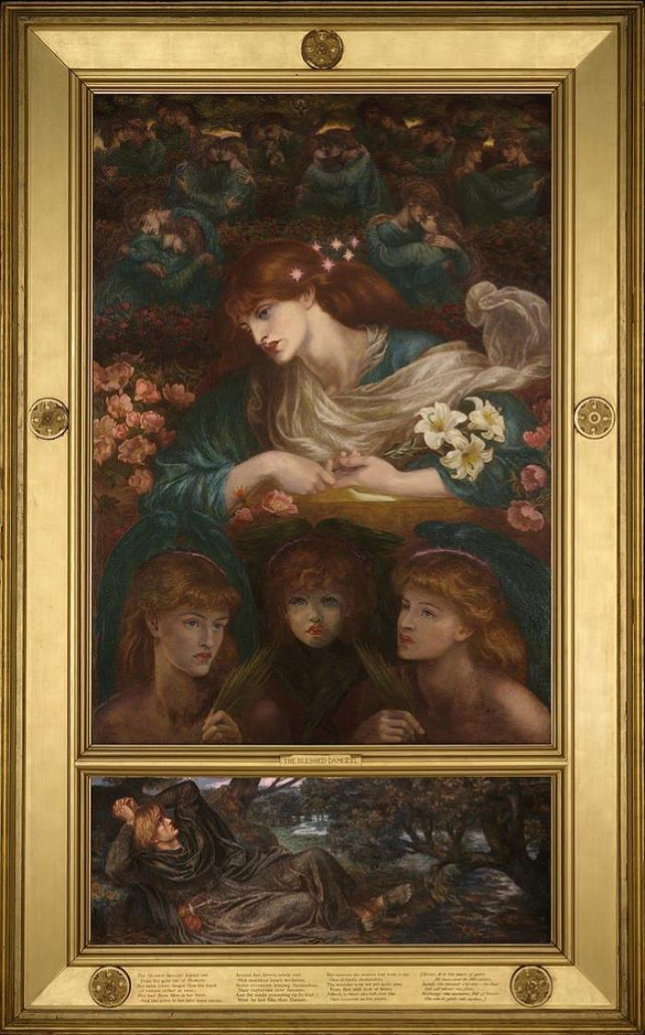
Dante Gabriel Rossetti’s The Blessed Damozel.
(1877).
Alex Wilding is the model.

