Slide 1
The Victorian Circus
Ellen Sundermeier
ENG 470
September 15, 2021

Slide 2
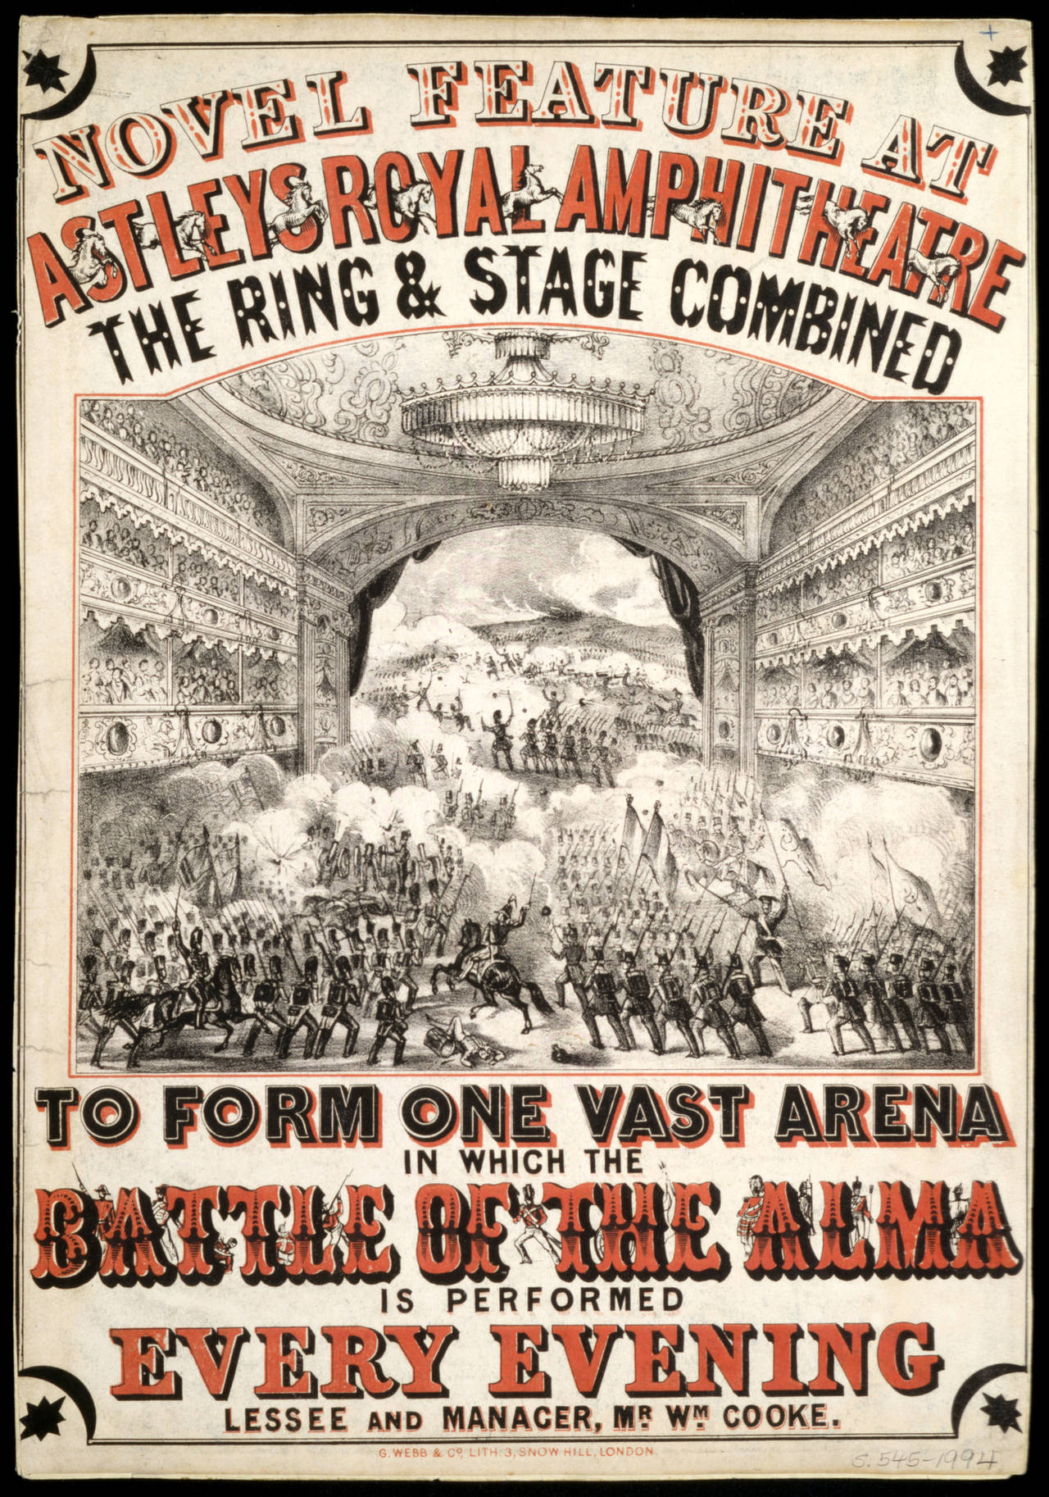
A Brief Overview
Victorian circus featured the body in terms of skill rather than abnormalities.
Appeal to the senses meant that it was appropriate for a wide range of classes, regions, and ages.
Trick riding was “the chief feature of the program” for much of the period (Assael 3).
Organization of the circus into one program performed in a tent or amphitheater as a commercial enterprise happened in late 18th to early 19th centuries.
1854 Circus Poster

Slide 3
Victorian Circus History
1768-1820: Astley’s Amphitheater in Lambeth
1820-1860: Grand equestrian dramas with 20-30 horses
1860-1880: Variety acts began to overshadow equestrian dramas
1880-1900: Increases in size and capital, introduction of wild animals

Slide 4
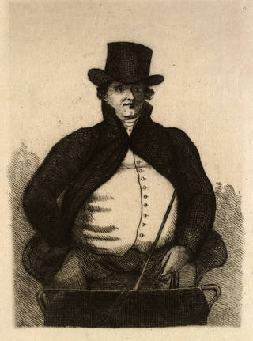
Philip Astley
Credited as the “father of the modern circus”
Distinguished himself in his army days with his remarkable skill in horse training and riding
Started a circus in London in 1768
Used trick riding, educated horses, and clown pantomimes to draw crowds
Spent the next 46 years developing equestrian entertainment
Print of Philip Astley, 1800

Slide 5
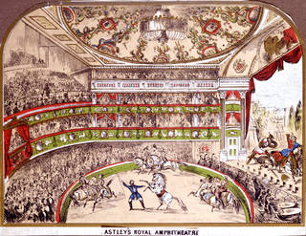
1772 Circus Advertisement
“Horsemanship and New Feats of Activity. This and every evening at six, Mr. and Mrs. Astley, Mrs. Griffiths, Costmethopila, and a young Gentleman, will exhibit several extraordinary feats on one, two, three, and four horses, at the foot of Westminster Bridge…Between the acts of horsemanship, a young Gentleman will exhibit several pleasing heavy balances, particularly this night with a young Lady nine years old, never performed before in Europe…Mrs. Astley will likewise perform with two horses in the same manner as she did before their Majesties of England and France, being the only one of her sex that ever had that honour” (Quoted in Manning-Sanders 36-37).

Slide 6
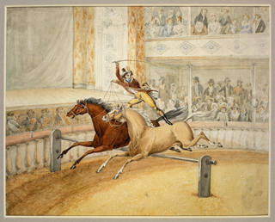
Andrew Ducrow
Known as the “father of British circus equestrianism”
Born in London and trained in circus skills from a young age
Took over management of Philip Astley’s Amphitheatre in 1824
Famous for his act ’The Flying Wardrobe’
Oversaw staging of popular equestrian dramas
Drawing of Andrew Ducrow
by William Heath, about 1830

Slide 7
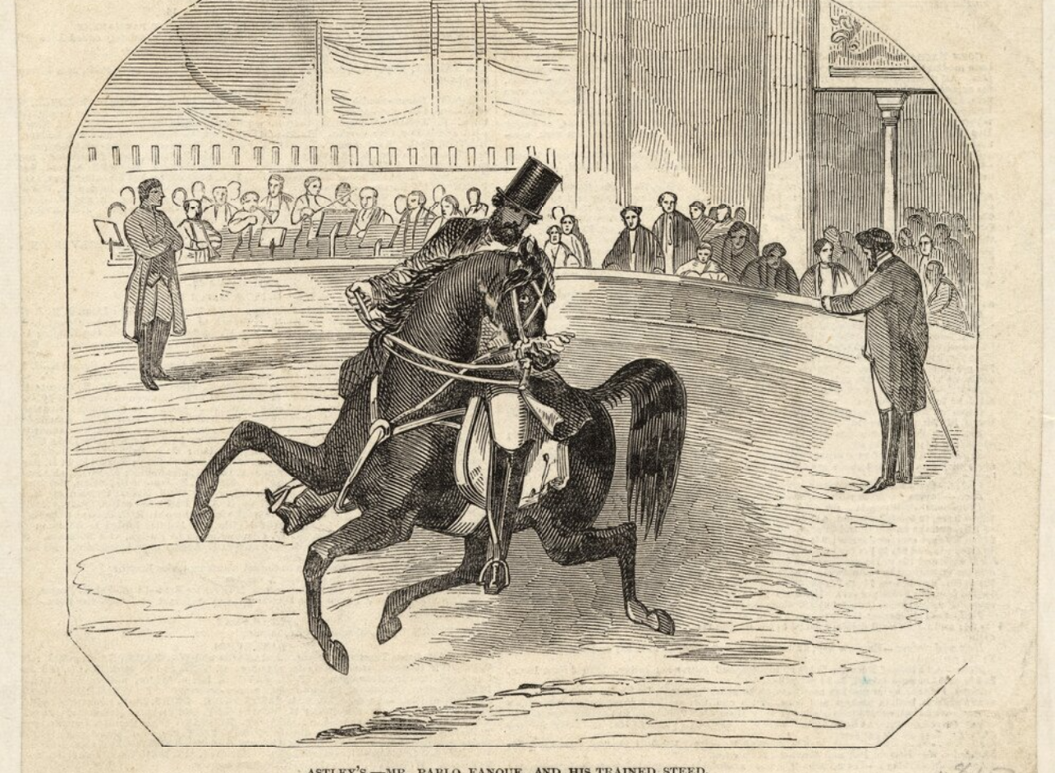
Trick Riding
Somersaulting on horseback
Pirouette on horseback
Back somersault from one horse to another
Forward-forward
Pas-de-deux
The Handkerchief Trick
Pablo Fanque, popular trick rider of the 19th century; first black equestrian to perform in a circus

Slide 9
Works Cited
Assael, Brenda. The Circus and Victorian Society. University of Virginia Press, 2005.
G. Webb & Co. Poster advertising The Battle of the Alma at Astley’s Royal Amphitheatre. 1854. V&A, https://www.vam.ac.uk/articles/the-story-of-circus#slideshow=58613815&slide=9.
Interior view of Astley’s Royal Amphiteatre. 19th Century. V&A, https://www.vam.ac.uk/articles/the-story-of-circus#slideshow=58613815&slide=9.
Heath, William. Drawing of Andrew Ducrow. about 1830. V&A, https://www.vam.ac.uk/articles/the-story-of-circus#slideshow=58613815&slide=9.
Manning-Sanders, Ruth. The English Circus. Norhumberland Press, Ltd., 1952.
Newspaper cutting depicting Pable Fanque at Philip Astley’s circus. V&A, https://www.vam.ac.uk/articles/the-story-of-circus#slideshow=58613815&slide=9.
Print depicting Philip Astley. 1800. V&A, https://www.vam.ac.uk/articles/the-story-of-circus#slideshow=58613815&slide=9.
“The Story of a Circus.” V&A, 15 Sept. 2021, https://www.vam.ac.uk/articles/the-story-of-circus#slideshow=58613815&slide=9.
Turner, John. Victorian Arena: The Performers: A Dictionary of British Circus Biography. vol. 1, Lingdales Press, 1995.
“Odysseo Trick Riding.” YouTube, uploaded by EquineVideoProd. 15 Sept. 2021, https://www.youtube.com/watch?v=gLWZrY-ZaA0&t=3s.

