Slide 1
trick mirror: Reflections on self delusion (2019)
By Jia Tolentino
JAN SUSINA – ENG 375
3/1/2022
PowerPoint by Olivia Godoy

Slide 2
Personal Essays
Introduction (IX)
“The I in the Internet” (3)
“Pure Heroines” (95)
“The Story of a Generation in Seven Scams” (157)

Slide 3
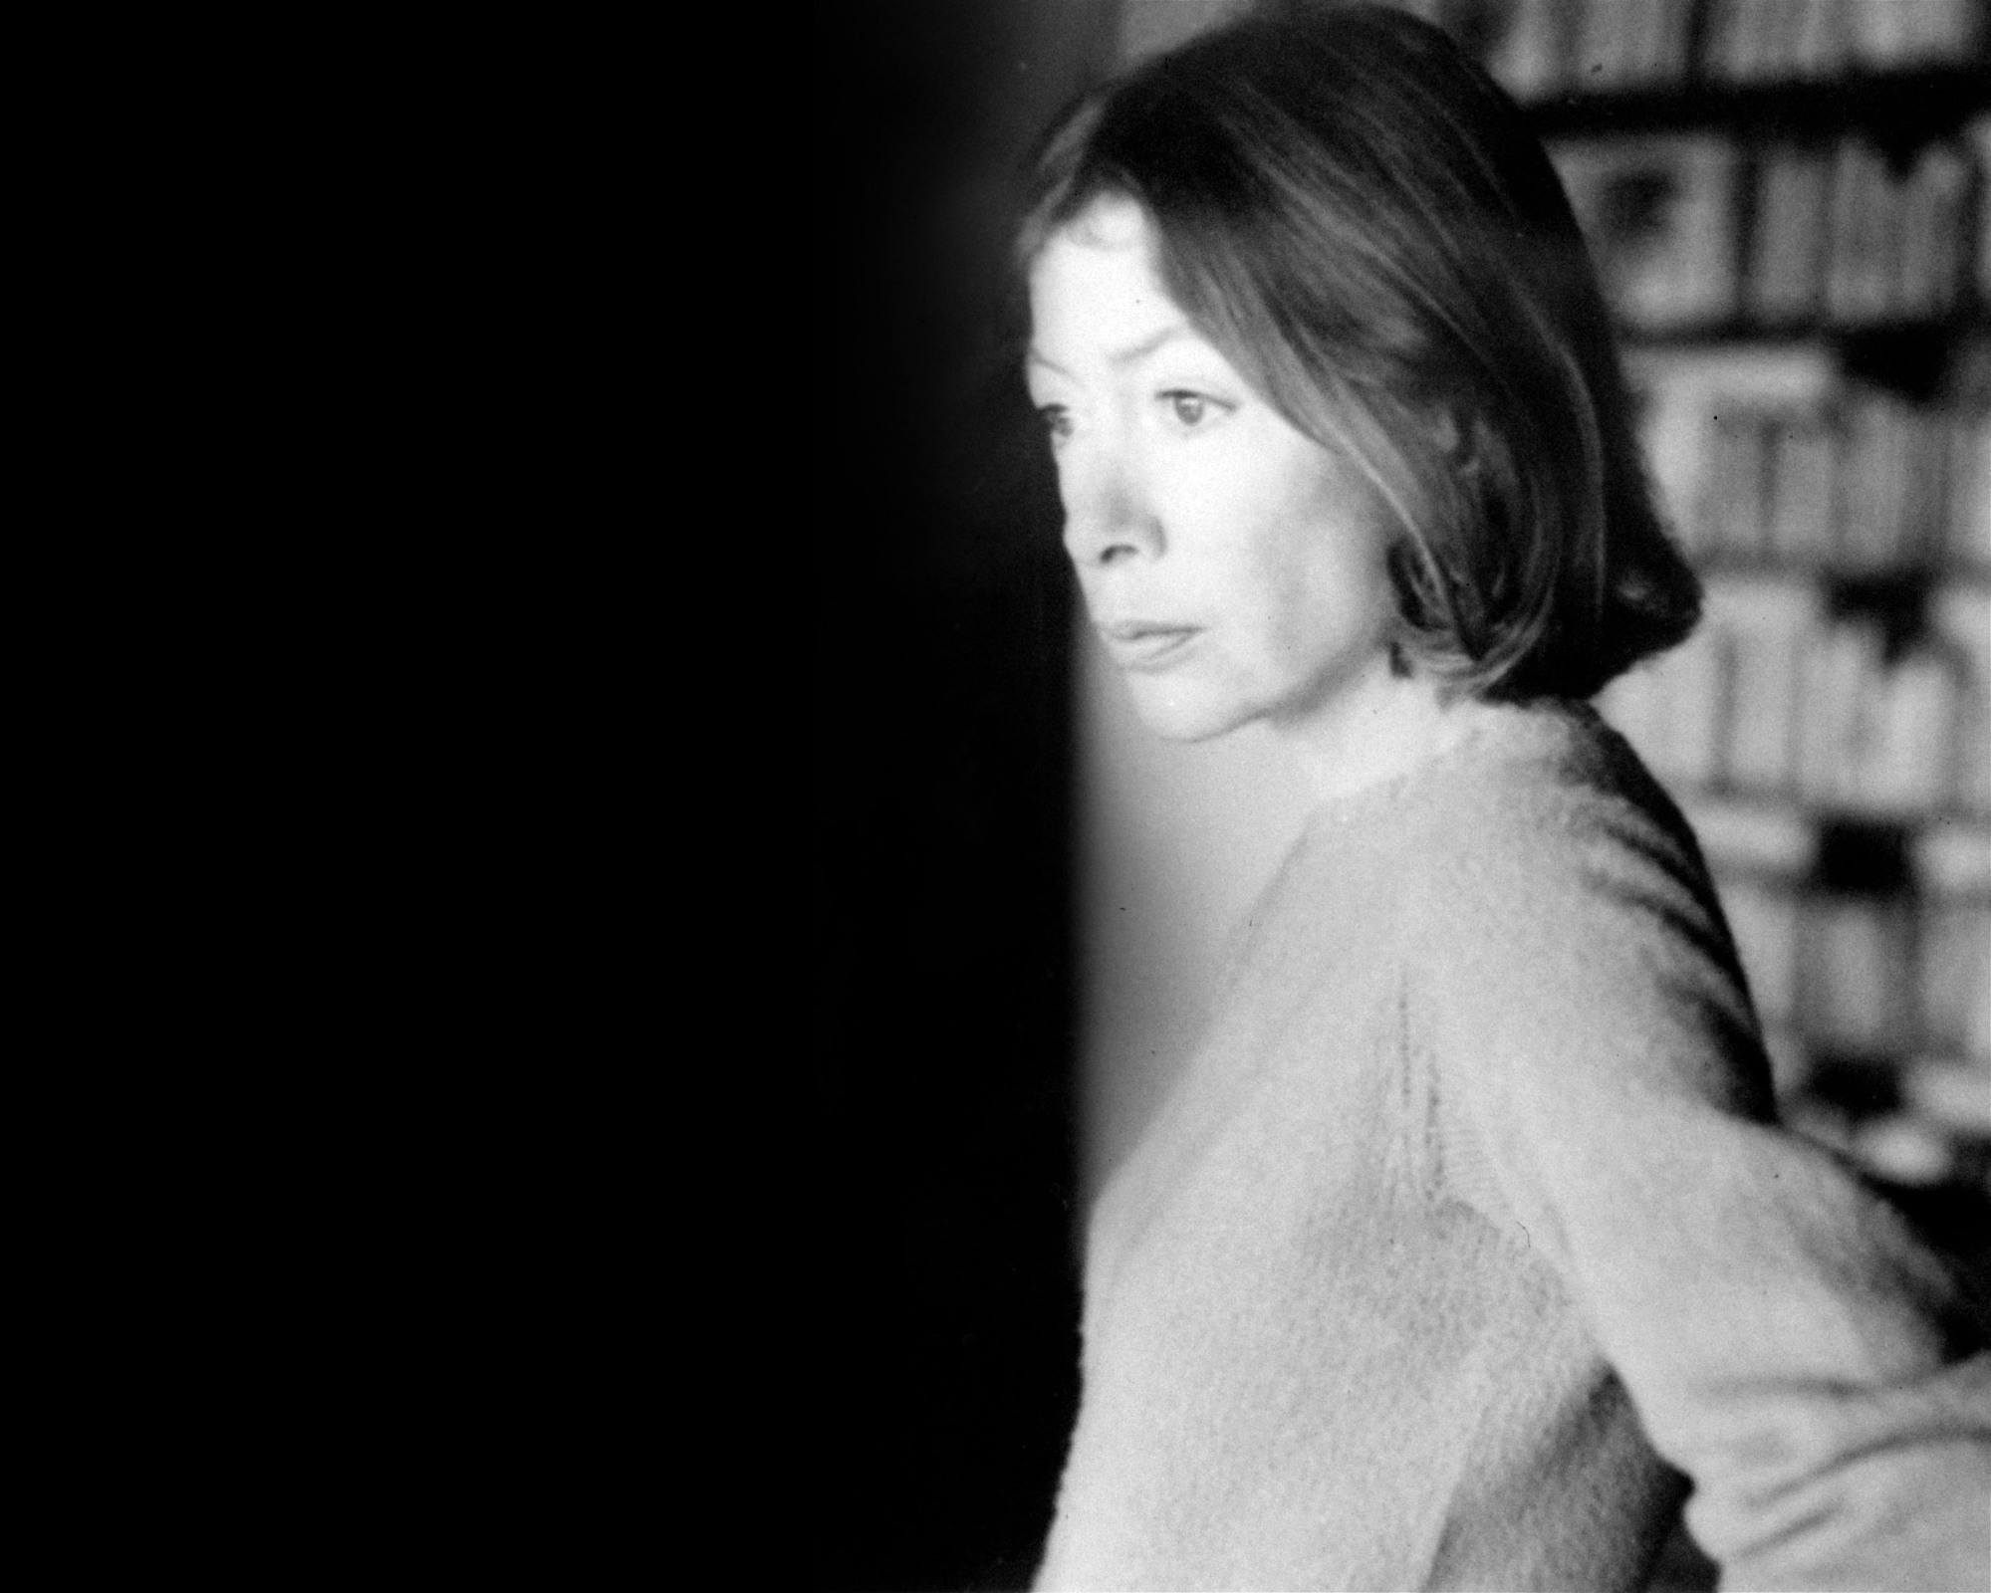
“We tell ourselves stories in order to live.”
-Joan Didion
The White Album (1979)
“Writers are always selling someone out.”
-Joan Didion
Slouching Towards Bethlehem (1967)

Slide 4
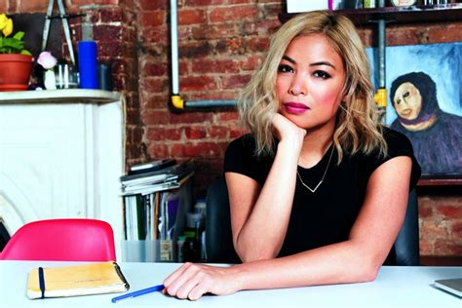
Jia Tolentino
University of Virginia – BA
University of Michigan – MFA
Peace Corps in Kyrgyzstan
Writer for:
The Hairpin (online)
Jezebel (online)
The New Yorker
Called the voice of her generation –
the millennial Joan Didion

Slide 5
INTRO
“When I feel confused about something,
I write about it until I turn into the person who shows up on paper:
a person who is plausibly trustworthy, intuitive, and clear.”

Slide 6
INTRO
“The last few years have taught me to suspend my desire for conclusion, to assume that nothing is static and renegotiation will be perpetual, to hope primarily that little truths will keep emerging in time.”
Affinity for complexity and contradiction
Essays follow her mind as she figures things out

Slide 7
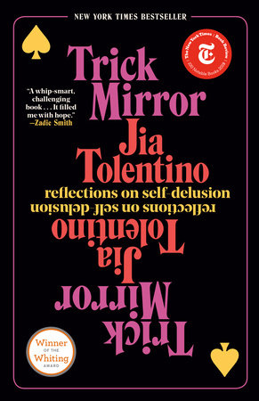
INTRO
Title: Trick Mirror: Reflections on Self Delusion
from an essay in Jezebel (2015)
Feminist websites serve as a “trick mirror that carries the illusion of flawlessness as well as self-flagellating option of constantly finding fault”

Slide 8
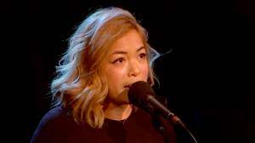
P. 3
“The I in the Internet”
Internet seems good but does bad (11)
Addicted to the web
Platforms promise to connect but provide alienation (8)
Internet is the central organ of contemporary life
Ervin’s Goffman – Presentation of Self in Everyday Life
Performance on the internet – one's online identity/self-promotion
Internet is a poor substitute for political engagement (18)
Notes:
Blue = confused

Slide 9
P. 95
“The I in the Internet”
“Writing is my only strategy for making this conflict go away.”
“Writing is either a way to shed my self-delusions or a way to develop them.”
“These essays are about the spheres of public imagination that have shaped my understanding of myself, of this country, and of this era.” (intro)

Slide 10
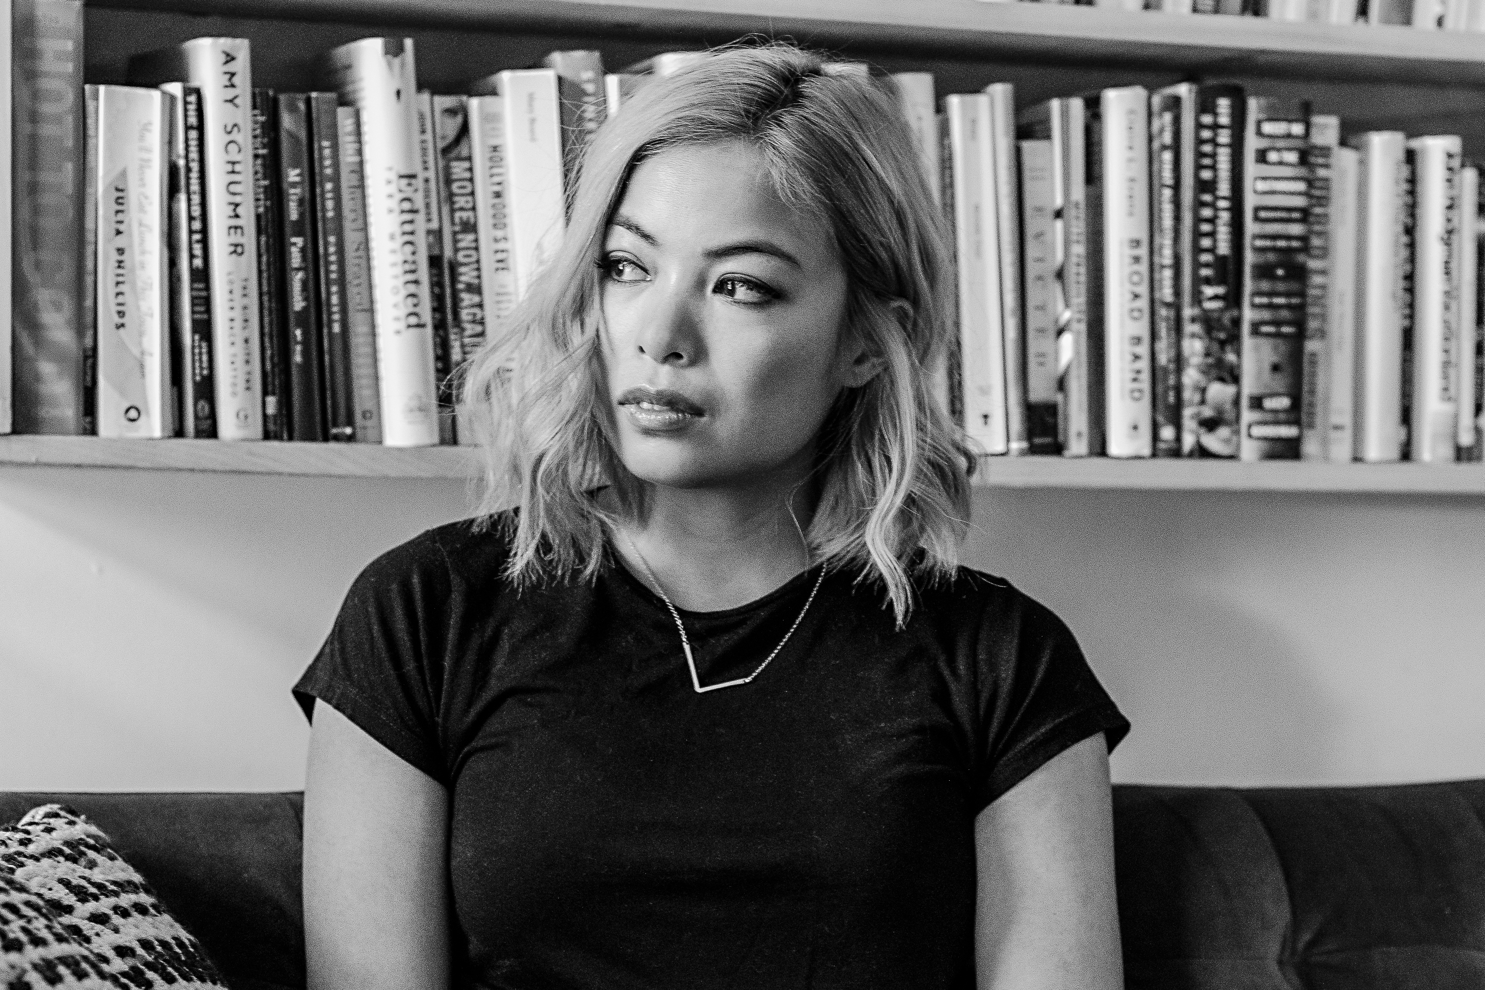
“Pure Heroines”
P. 95
“the stories we live
and the stories we read
are to some degrees inseparable” (95)

Slide 11
“Pure Heroines”
P. 95
Children’s Books: innocence
From the Mixed-Up Files
Little House series
Ramona series
Harriet the Spy
Anastasia Krupnik
YA Books: sad and traumatic
Bell Jar
Virgin Suicides
Twilight
Adult Books: bitter and dead
Madame Bovary
Anna Karenina
The Awakening

Slide 12
“Pure Heroines”
P. 95
Children’s Books:
the characters I wanted to be
YA Books:
showed me who I was afraid to become

Slide 13
“The Story of a Generation in 7 Scams”
P. 157
2008 Stock Market Crash (163)
Student debt (167)
Social media (170) – Facebook
Girlbosses (175) – NastyGal
Obvious ones (180) – Raw water, Juicero
Disruptors (184) – Amazon, Uber, Air bnb
Election/Trump (190)
Billy McFarland’s Fyre Festival
1st all-millennial scam event (162)

Slide 14
trick mirror: Reflections on self delusion (2019)
By Jia Tolentino
JAN SUSINA – ENG 375
3/1/2022
PowerPoint by Olivia Godoy

