Slide 1
The Importance of Being Earnest by Oscar Wilde

Slide 2
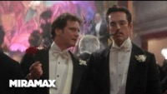
Jack or Earnest?

Slide 3
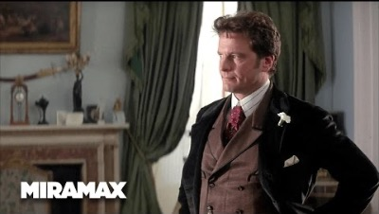
The Importance of Being Earnest | 'Bunbury' (HD) | MIRAMAX

Slide 4
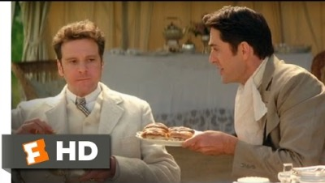
The Importance of Being Earnest (9/12) Movie CLIP - Eating Muffins Agitatedly (2002) HD

